Slide 1
AWS ASSIGNMENT
Q1.creation of two linux instance
Q2.Elastic load balance

Slide 2
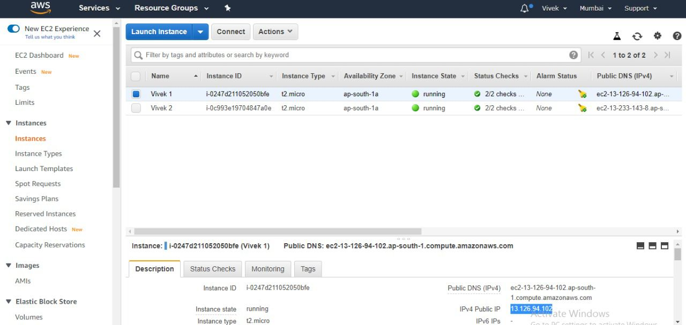

Slide 3
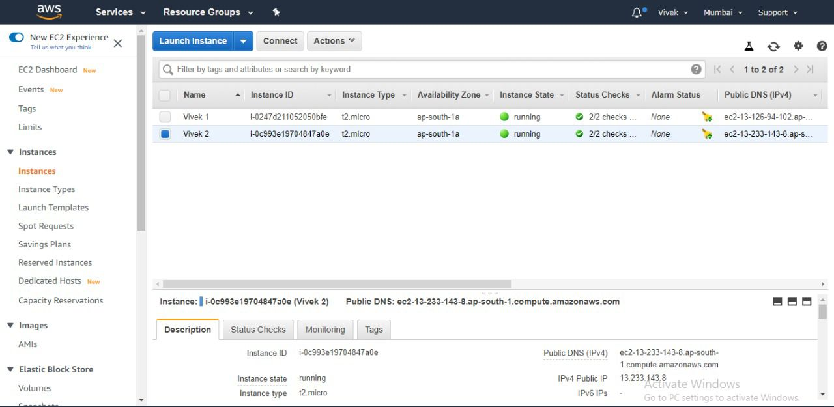

Slide 4
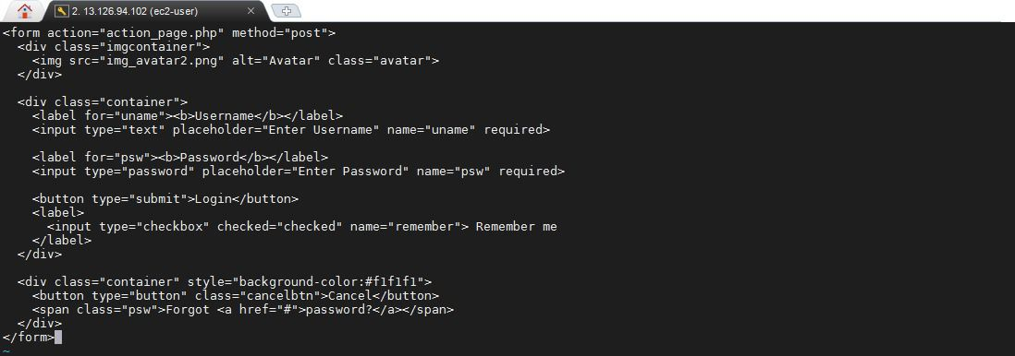
Source code for 1st instance

Slide 5
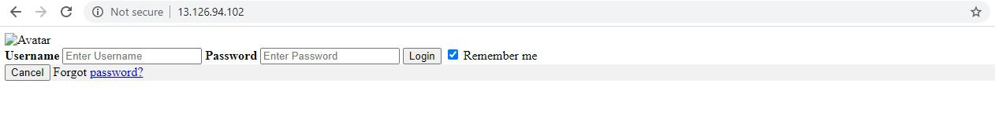
Form for first instance

Slide 6
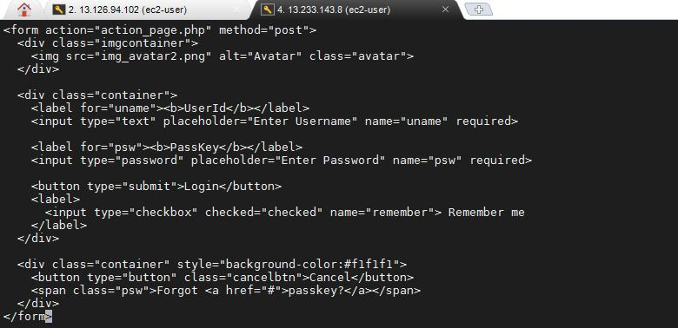
Source code for secound instance

Slide 7
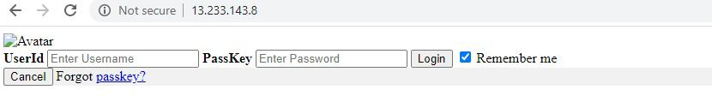
Form for secound instance

Slide 8
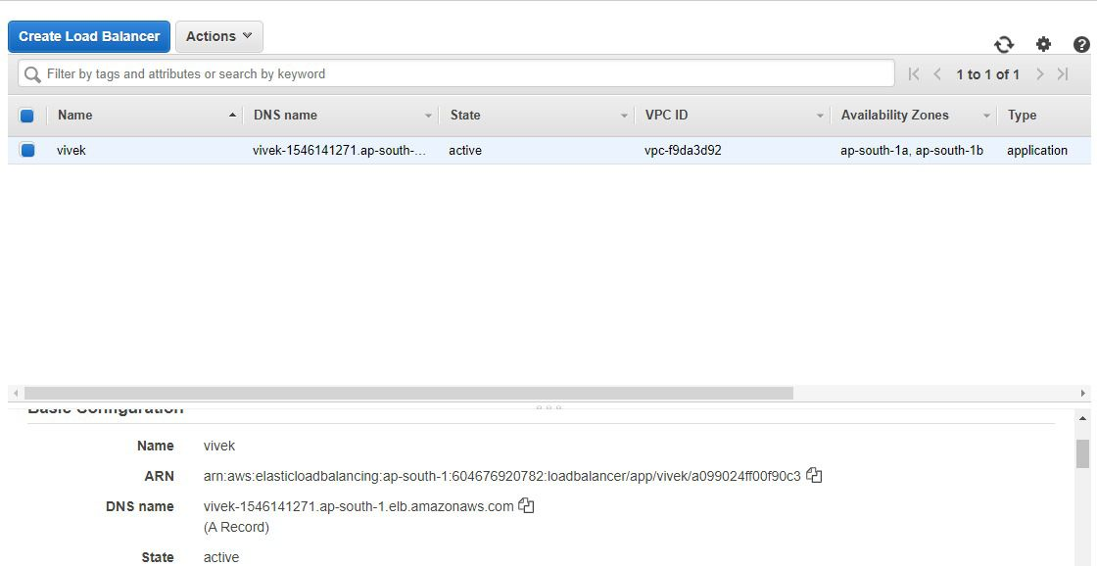
Elastic load balancer

Slide 9
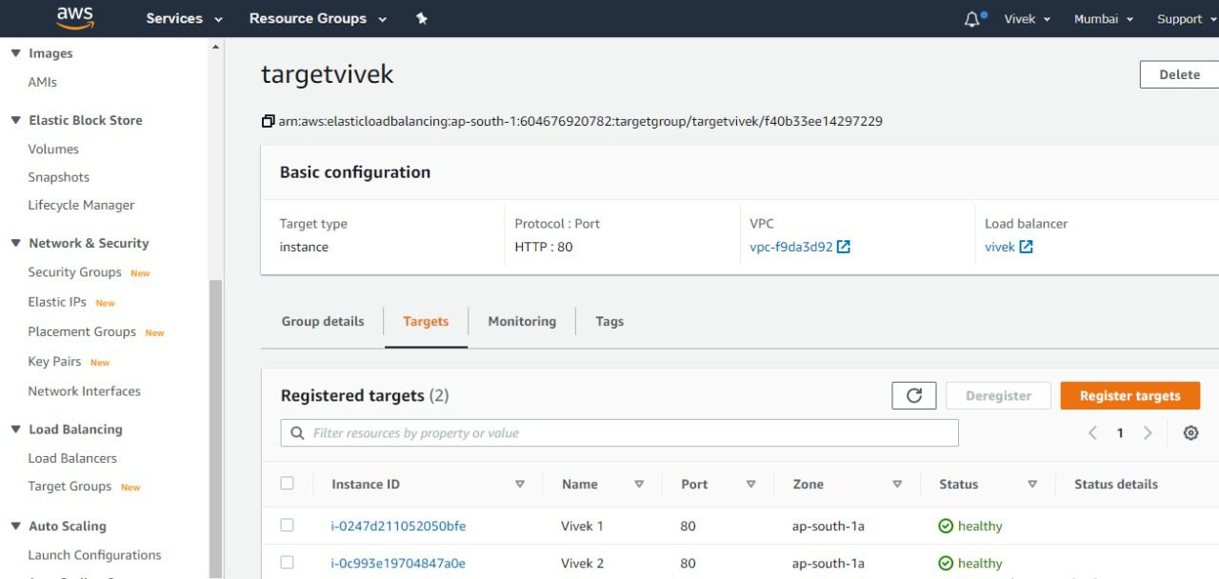
Health of ELB

